Slide 1
Introduction to
Academic Affairs
Academic Office
International School
September 2020

Slide 2




Academic Office
Office Location：Room 101, Xikanglu campus
Office number: +86 25 83786244
Email: ie_academic@hhu.edu.cn
Academic Affairs of Degree students
  including Students’ status Management
  Management of Courses, Transcripts and Degree Certificates

Slide 3
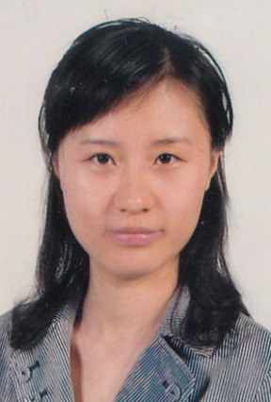
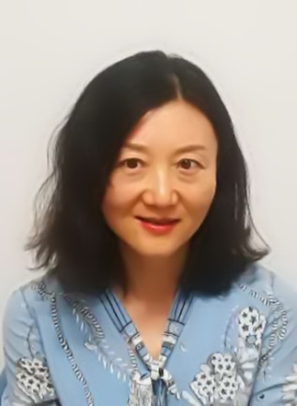

Academic Office
Name: LI Junyu
Contact: lijunyu@hhu.edu.cn
Work content: Academic affairs of Postgraduate Students
Name: YANG Li (Emily)
Contact: 19961396@hhu.edu.cn
Work content: Academic affairs of Undergraduate Students

Slide 4
目录Menu
1. Regulations for Studies
学习相关规定
2. Bachelor Courses Arrangement
本科生课程安排
3. Graduate Courses Arrangement
研究生课程安排
4. Chinese Language Students
汉语生课程安排

Slide 5
1. Regulations for Studies
学习相关规定

Slide 6
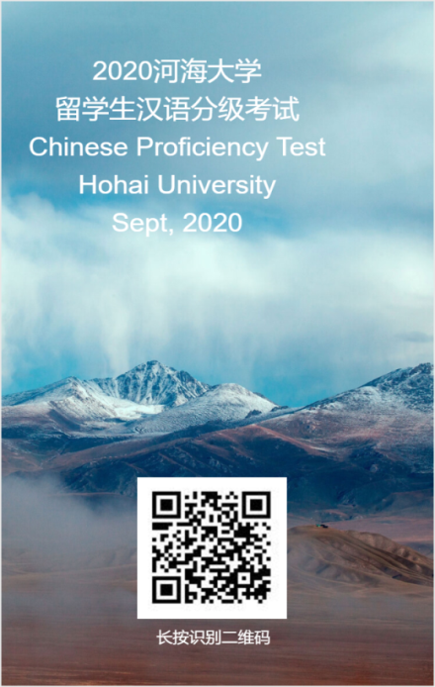
Requirements of
Chinese Language
汉语水平要求
自2019年9月入学的学生，毕业时汉语水平需达到以下要求：
研究生，英文授课项目：三级；
本科生，英文授课项目：四级；
本科生，中文授课项目：五级。
All the international students enrolled after September 2019, the Chinese proficiency should achieve the following requirements before graduation:
Postgraduates, English taught program, HSK 3;
Bachelor, English taught program, HSK 4;
Bachelor, Chinese taught program, HSK 5.

Slide 7
《来华留学研究生论文工作指导手册》
Thesis Handbook for
International Student
《来华留学本科生考勤本》
Attendance Notebook for
International Bachelor Students
《关于研究生中的留学生发表学术论文的补充通知》
Supplementary Notice for
Publishing Academic Papers
by International Graduate
Students
Related
Regulations&
Handbook
《教育部、外交部、公安部42号令》
New
New
《河海大学外国留学生学籍管理办法》
Regulations on Education Registration Management of International Students of Hohai University
Note: Please download it from following website：
http://ie.hhu.edu.cn/

Slide 8
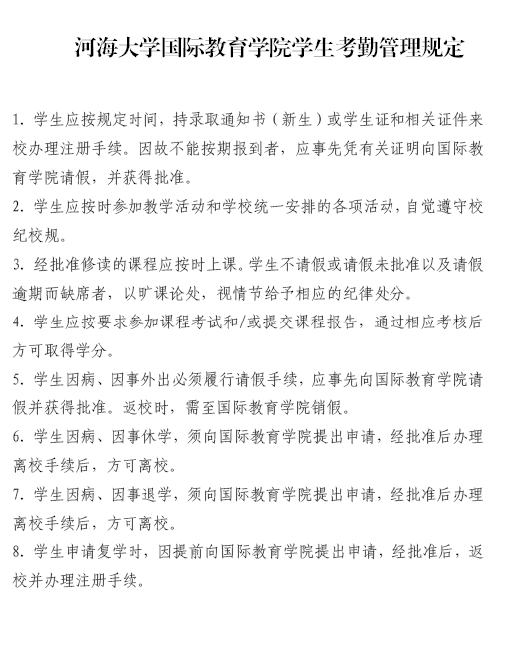
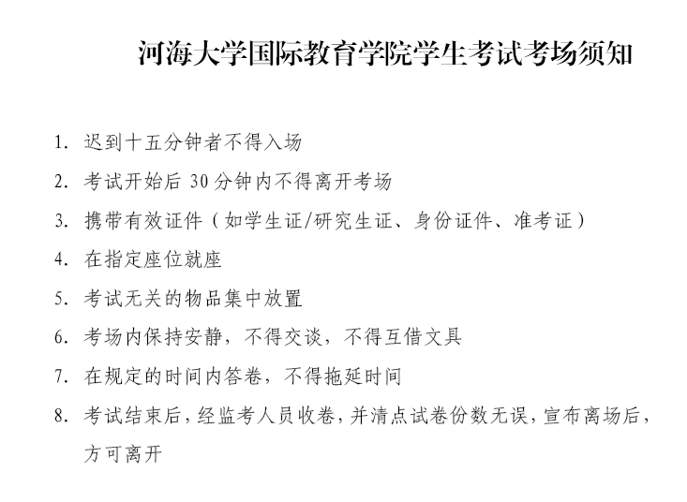
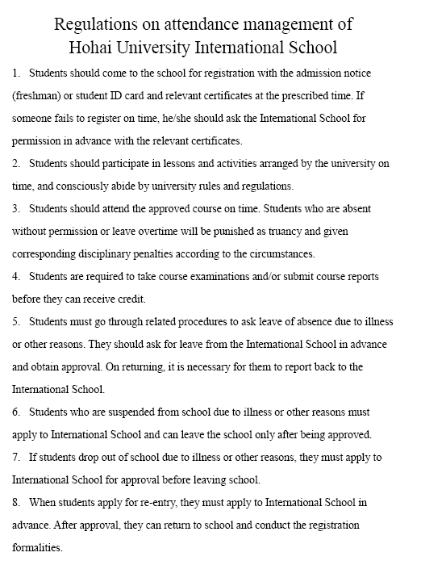
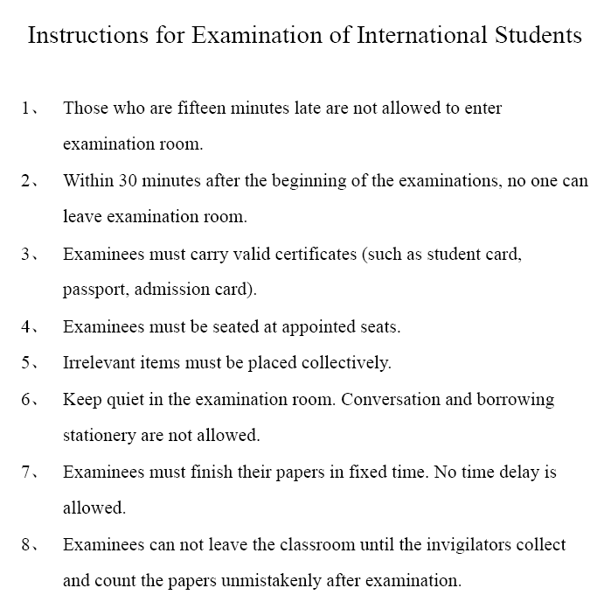
See from the website
http://hhis.hhu.edu.cn/5046/list.htm
Regulations
Regulations on the
attendance management
Instructions for Examination

Slide 9
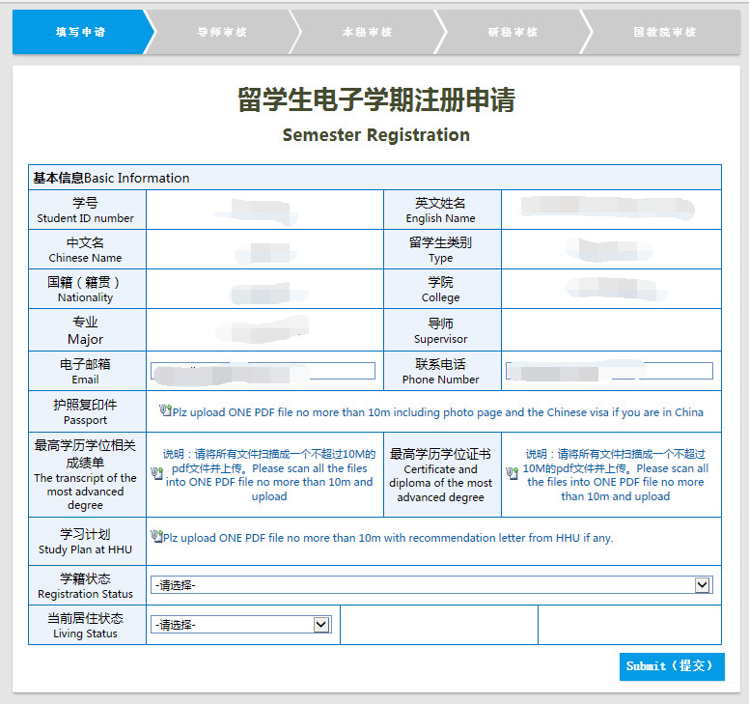
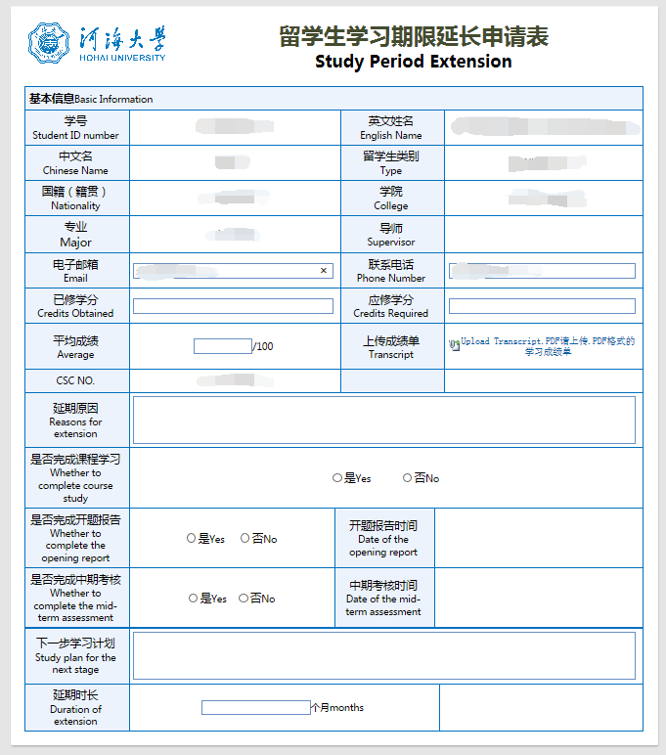
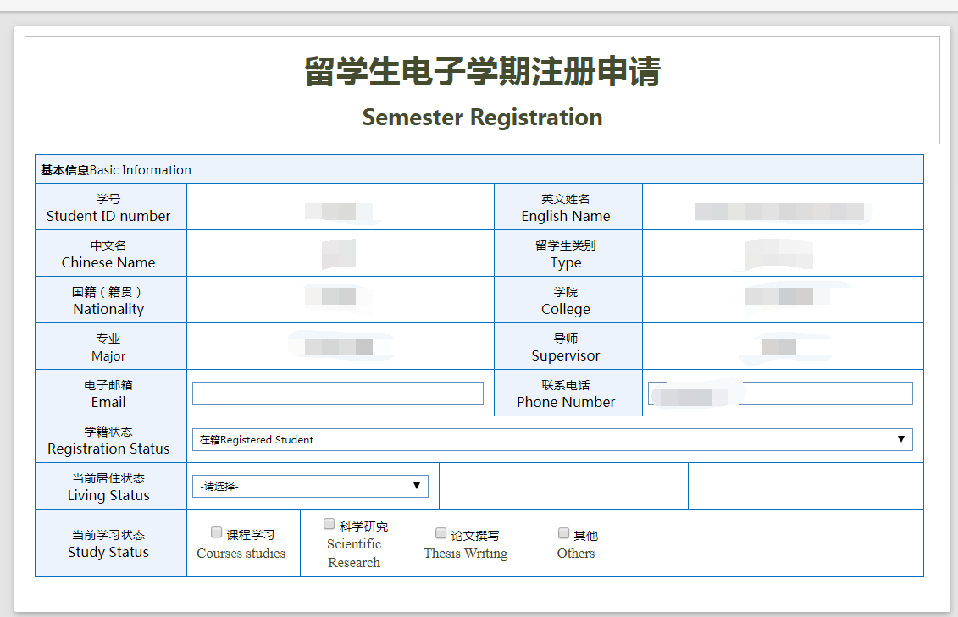
Online Application
http://ie.hhu.edu.cn/_s149/p7352c7346/list.psp
留学生电子学期注册申请
Semester Registration
留学生学习期限延长申请
Study Period Extension

Slide 10
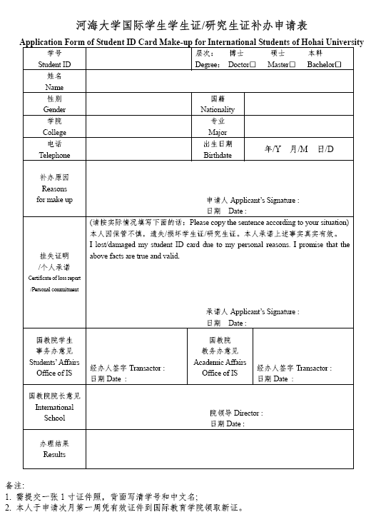
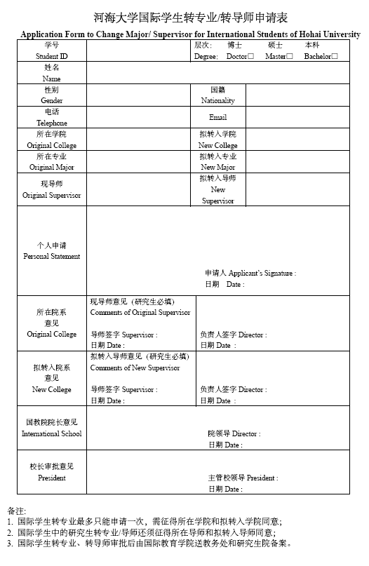
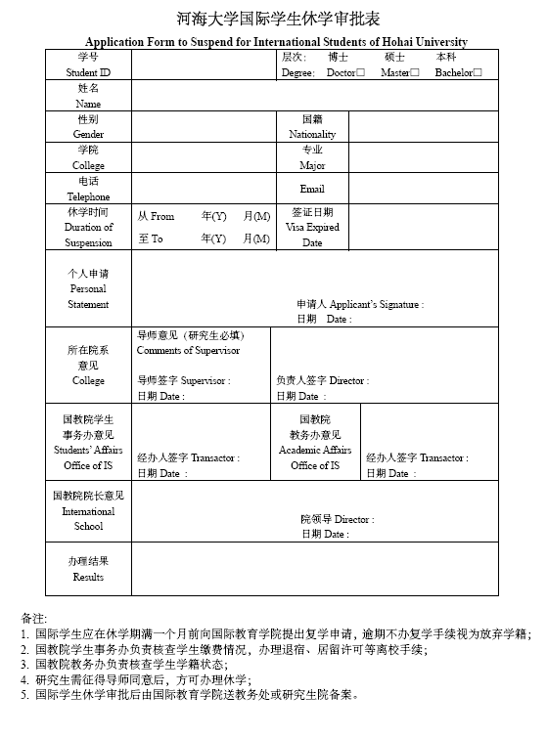
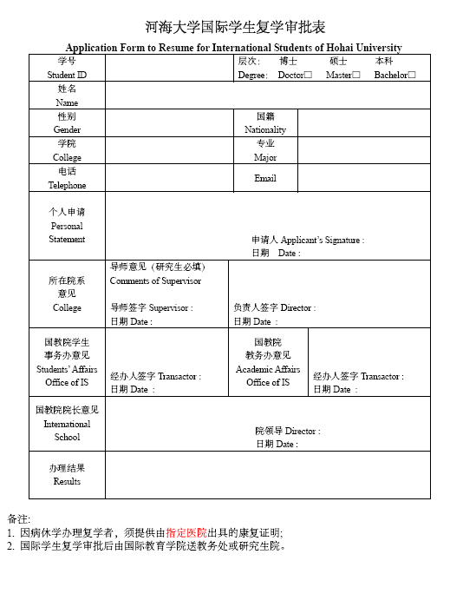
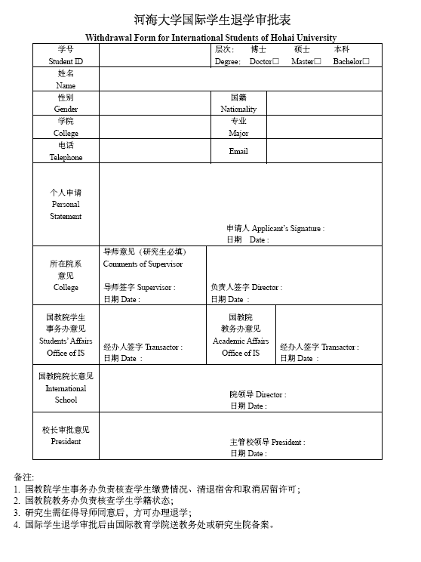
Download from the website
http://ie.hhu.edu.cn/p7352c7346/list.htm
Some Forms
Student ID Card Make-up
Change Major / Supervisor
Suspension of Studies
Resumption of Studies
Quit Studies
... …

Slide 11
Regulations
& Handbook
本科生学制4年，根据《河海大学外国留学本科生学籍暂行管理办法》第十五条“留学生课程总成绩由平时成绩和期末考试成绩组成，两者各占50%。其中平时成绩由任课教师根据留学生平时到课等情况综合评定”。
留学研究生培养可参考《河海大学来华留学研究生论文工作指导手册》：
硕士研究生学制3年，毕业需要28个学分，申请学位时对其发表学术论文不做明确要求。
博士研究生学制4年，毕业需要15个学分，申请学位时需满足以下条件：
The duration of undergraduate program is 4 years.
The total score of the bachelor‘s courses consists of attendance (50%) and final examination score (50%).
The master program is 3 years and 28 credits are required for the application of degree.
The doctoral program is 4 years and 15 credits are required for the application of degree. To apply for a doctoral degree, the following conditions should be met:

Slide 12
International doctoral candidates should satisfy the following conditions when apply for degree
理学、工学学科门类博士 doctor degree in science and engineering
法学、管理学学科门类博士 doctor degree in law and management
The paper published requires:
The student as the first author
The student as the second author and the the supervisor as the first author
The first affiliated institution should be Hohai University.
请注意所发表的论文要求
学生第一作者;
学生第二作者，指导教师第一作者;
第一作者署名单位为河海大学。
申请法学、管理学学科门类的博士学位者，发表的学术论文应符合以下条件之一：①有2篇学术论文被EI收录或发表在CSSCI检索源期刊上；②有1篇学术论文被EI收录和2篇学术论文发表在中文核心期刊或国外学术期刊；③有一篇学术论文发表在CSSCI检索源期刊上和2篇学术论文发表在中文核心期刊或国外学术期刊。④有3篇学术论文发表在中文核心期刊或国外学术期刊上。
a. Two papers are included in EI or published in Chinese Social Sciences Citation Index (CSSCI)
b. One paper is included in EI and two papers are published in Chinese Core Journals or foreign academic journals
c. One paper is published in CSSCI and two papers are published in Chinese Core Journals or foreign academic journals
d. Three papers are published in Chinese Core Journals or foreign academic journals.
申请理学、工学学科门类博士学位者，发表的学术论文应符合以下条件之一：①有两篇学术论文被EI收录；②有一篇学术论文被EI收录和2篇学术论文发表在中信所检索源学术期刊或国外学术期刊；③有三篇学术论文发表在中信所检索源学术期刊或国外学术期刊上。
a. Two papers are included in Engineering Index (EI)
b. One paper is included in EI and two papers are published in Institute of Scientific and Technical Information of China (ISTIC) retrieval source academic journals or foreign academic journals
c. Three papers are published in ISTIC retrieval source academic journals

Slide 13
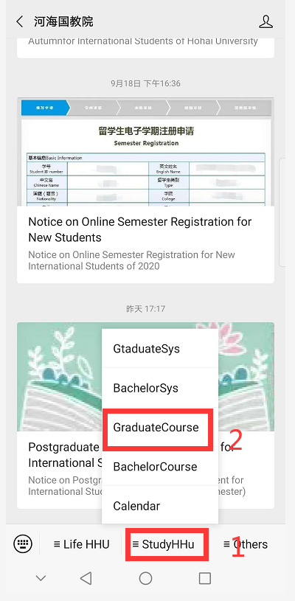
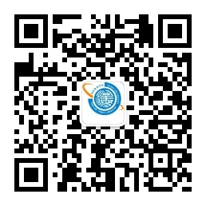
Courses Arrangement
In our wechat “河海国教院”, you can find the function “StudyHHU”. Let us explore more information about the courses and online system together!

Slide 14
2. Bachelor Courses Arrangement
本科生课程

Slide 15
Bachelor Courses Arrangement
Courses of the first year are arranged by International School. From the second year, all the bachelor students should take courses with Chinese students. At the beginning of every semester from the second year, you should also go to your college to get timetable.
本科生教学秘书 Bachelor Teaching Secretary
序号 | 学院 | College | Contact | Telephone
1 | 水文院 | College of Hydrology and Water Resources | 史静 | 83787365/58099422
2 | 水电院 | College of Water Conservancy and Hydropower Engineering | 高冀颖 | 83786931/58099432
3 | 港航院 | College of Harbor, Coastal and Offshore Engineering | 刘瑶 | 83786187
4 | 土木院 | College of Civil and Transportation Engineering | 陈鹏 | 83787605/58099404
5 | 环境院 | College of Environment | 李洋 | 83786971
6 | 能电院 | College of Energy and Electrical Engineering | 李薇薇 | 58099094
7 | 计信院 | College of Computer and Information Engineering | 陈静 | 58099109
8 | 力材院 | College of Mechanics and Materials | 李静 | 83786410
9 | 地学院 | College of Earth Science and Engineering | 郑茜丹 | 58099141
10 | 农工院 | College of Agricultural Engineering | 王薇薇 | 83786947
11 | 海洋院 | College of Oceanography | 李燕 | 83787813
12 | 理学院 | College of Sciences | 李成翠 | 58099160
13 | 商学院 | Business School | 黄艳 | 58099216
14 | 公管院 | School of Public Administration | 刘芹 | 83786381
本科生一年级的课程由国际教育学院安排。从二年级起，所有留学本科生与中国学生同堂上课。从二年级起，每学期开学时，请去专业学院领取课表。

Slide 16
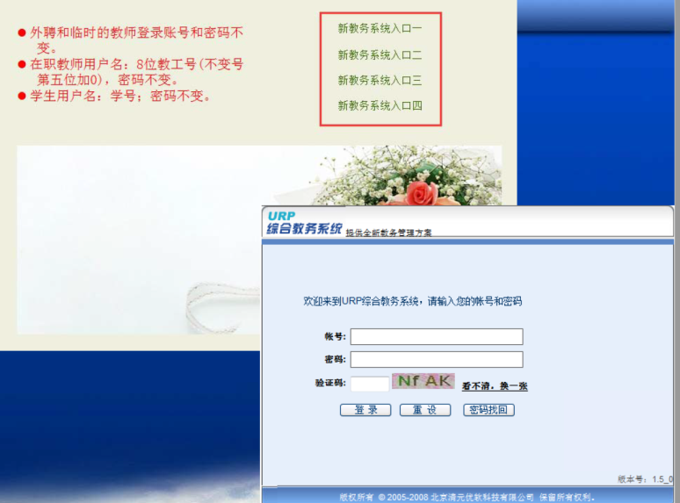
Bachelor Courses Arrangement
The handbook of online system is on our website.
http://ie.hhu.edu.cn/2016/0918/c7339a99099/page.htm
本科生综合教务系统的使用手册和网址如下：
The online system is http://202.119.113.135/xkgg.html
The online system offers the following functions:
course selection
program review
grade query
lecturer evaluation
retake courses application
etc.
You don’t need to select any course for the first year. The university (the teaching affairs department) will set the timetable into your account.
本科生第一年不需要在线选课。
该系统可提供选课、查看培养方案、查询成绩、评教评学和重修报名等功能。
2020级留学本科生将通过“河海大学课堂在线平台”，实施线上课程。
the online courses will be implemented for undergraduate students in the fall semester of 2020 through the "Online Platform of Hohai University".
http://hhu.fanya.chaoxing.com/portal

Slide 17
3. Graduate Courses Arrangement
研究生课程

Slide 18
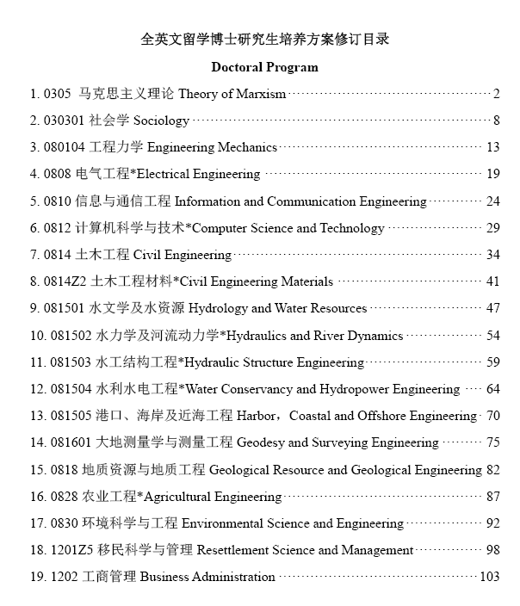
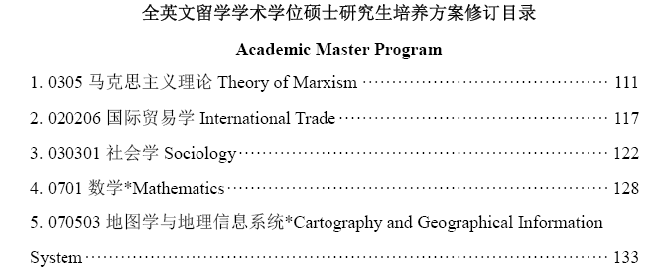
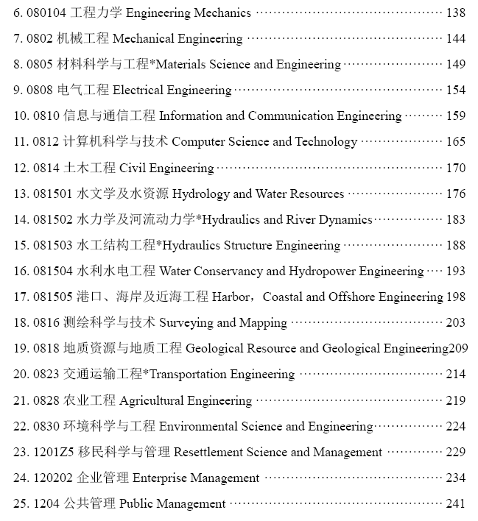
Program for International Graudate students (2017)
留学研究生培养方案 (2017版)
http://ie.hhu.edu.cn/2017/0914/c7304a155573/page.htm
Online system http://yjss.hhu.edu.cn/gmis/home/stulogin

Slide 19
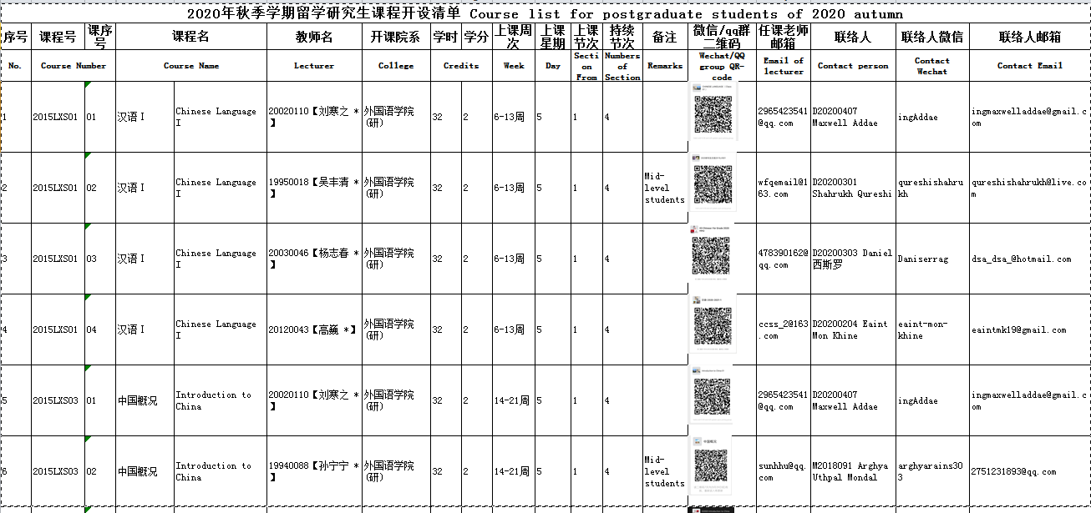

Graduate Courses Arrangement
Please refer to our website for more information and see the update of courses.
http://ie.hhu.edu.cn/2020/0922/c7339a212757/page.htm

Slide 20
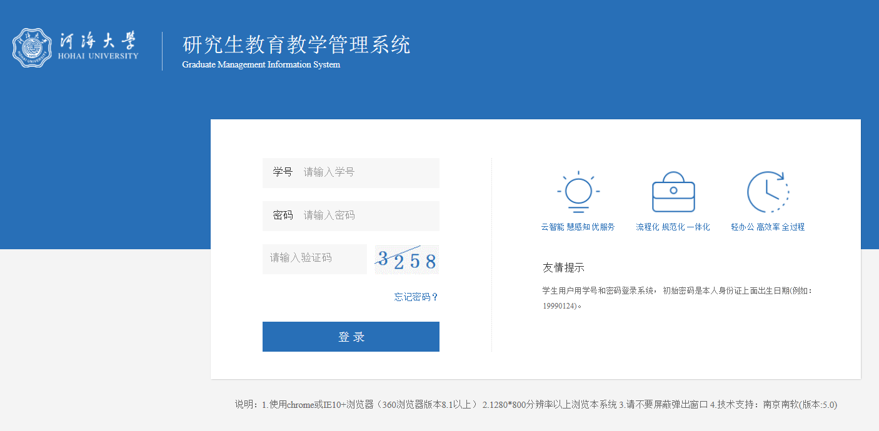
Graduate Courses Arrangement
All the graduate students should select courses in the online system, please read the handbook of the online system on our website.
http://ie.hhu.edu.cn/2016/0913/c7339a99075/page.htm
The online system is http://yjss.hhu.edu.cn/gmis/home/stulogin
The online system offers the following functions:
course selection
program review
grade query
transcripts print
study certificate print
personal contact info modification
etc.

Slide 21
Graduate Courses Arrangement
The arrangement of supervisor and the application of pre-defense, defense are in the college..
The approval of transcripts is in International School.
研究生教学秘书 Graduate Teaching Secretary
# | 学院 | College | Contact | Telephone | Office | Campus
1 | 水文院 | College of Hydrology and Water Resources | 许睢 | +86 25 83786614 | 工程馆314 | 西康路Xikanglu
2 | 水电院 | College of Water Conservancy and Hydropower Engineering | 周昶/柳璐 | +86 25 83786922 | 水电馆311 | 西康路Xikanglu
3 | 港航院 | College of Harbor, Coastal and Offshore Engineering | 郝晓美 | +86 25 83786187 | 严恺馆623 | 西康路Xikanglu
4 | 土木院 | College of Civil and Transportation Engineering | 刘瑾 | +86 25 83786552 | 科学馆503 | 西康路Xikanglu
5 | 环境院 | College of Environment | 张文翠 | +86 25 83786697 | 水利馆407 | 西康路Xikanglu
6 | 能电院 | College of Energy and Electrical Engineering | 曹东莉 | +86 25 58099096 | 勤学楼5312 | 江宁Jiangning
7 | 计信院 | College of Computer and Information Engineering | 吴晓丹 | +86 25 58099136 | 勤学楼4323 | 江宁Jiangning
8 | 力材院 | College of Mechanics and Materials | 贺蓓 | +86 25 83787027 | 乐学楼1107 | 江宁Jiangning
9 | 地学院 | College of Earth Science and Engineering | 俞冰 | +86 25 58099141 | 笃学楼909 | 江宁Jiangning
10 | 农工院 | College of Agricultural Science and Engineering | 曾欣 | +86 25 83772052 | 行政楼405 | 江宁Jiangning
11 | 海洋院 | College of Oceanography | 李燕 | +86 25 83787813 | 电气馆409 | 西康路Xikanglu
12 | 理学院 | College of Sciences | 李成翠 | +86 25 83786640 | 励学楼B213A | 江宁Jiangning
13 | 商学院 | Business School | 袁思源 | +86 25 68514309 | 博学楼206 | 江宁Jiangning
14 | 公管院 | School of Public Administration | 阮雪琴 | +86 25 83787376 | 厚学楼507 | 江宁Jiangning
15 | 机电院 | College of Mechanical and Electrical Engineering | 蔡伟 | +86 18906143866 | 英才楼A408 | 常州Changzhou
16 | 物联网院 | College of Internet of Things Engineering | 王海滨 | +86 18861194542 | 卓越楼1107 | 常州Changzhou

Slide 22
4. Chinese Language Students
汉语生课程安排

Slide 23
Chinese Language Students
包括以下课程 Courses include
综合汉语 COMPREHENSIVE CHINESE
汉语听说 LISTENING & SPEAKING
汉语读写 READING & WRITING
汉语口语 ORAL
课程时间 Period of courses
2020年10月12日- 2021年1月15日
From October 12, 2020 to January 15, 2021
  上课地点 Classroom
西康路校区闻天馆511
Wentian Building 511, Xikanglu Campus
期中考试 The mid-term exams
2020年11月23日至11月27日
From November 23 to November 27, 2020
期末考试 The final exams
2021年1月11日至1月14日
from January 11 to January 14, 2021
学习要求 The requirements of studies
按时出勤，认真上课，完成作业，参加考试
Attend class on time, finish homework and take exams as required
出勤率低于80%的学生将取消居留许可
Residence permits will be cancelled if the attendance below 80%

Slide 24





Regular Work Relevant to Students
Spring Semester
Fall Semester
Feb./March – August
Sep. – Jan./Feb.
Registration for degree students (Feb.)
Registration for degree students (Sep.)
Registration
Education
Arrangement of Courses (Feb.)
Arrangement of Courses (Sep.)
Delivery of graduation and degree certificate (March)
Delivery of graduation and degree certificate (June)
Delivery of graduation and degree certificate (September)
Delivery of graduation and degree certificate (Dec.)
Graduation
Jan
Feb
Mar
Apr
May
Jun
Jul
Aug
Sep
Oct
Nov
Dec

Slide 25


Regular Work Relevant to Students
新生报到
培 养
毕 业
（9月）
1）进行新生入学教育
2）开具相关学院报到注册函
3）本科生信息由教务处录入本科教务系统
4）研究生信息由研究生院录入研究生信息系统
5）学籍注册
1）为一年级本科生安排课程
2）为研究生安排课程
3）联系相关学院为研究生安排导师和课程
1）联系教务处、研究生院、相关学院确定毕业、结业学生名单
2）制作学历/学位中英文证书等毕业相关文件
3）协助学生办理离校手续
4）学历注册

Slide 26


